Slide 1
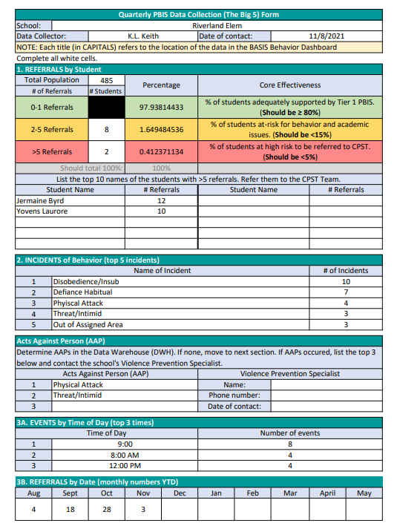
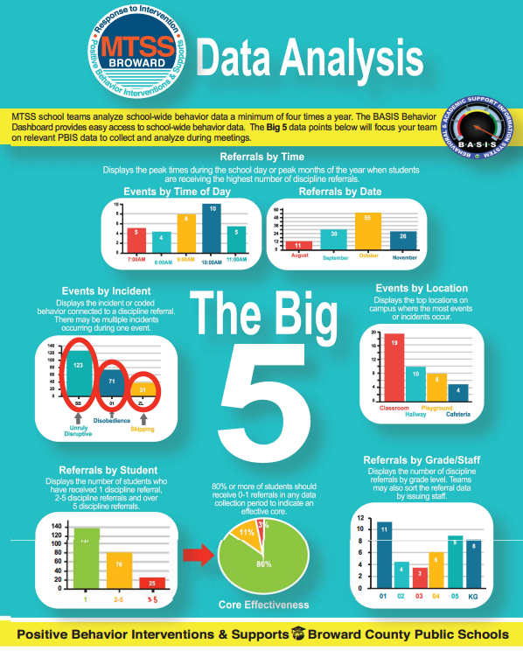
The Big 5

Slide 2
CHOOSE PEACE/STOP VIOLENCE
Michael Walker, Director

Slide 3
What can we do?
Choose Peace/Stop Violence (CPSV) is a comprehensive social norms initiative to educate, engage and empower youth to take action for the purpose of preventing bullying, youth violence, fostering social justice awareness to create safe and violence free environments and improving school climate through Positive Community Norms and Social Norms Marketing. The initiative promotes peace, positive change, social emotional learning competencies (self-management, social awareness, relationship skills, self-awareness and responsible decision-making). In addition, it fosters resiliency and how to deal with life challenges in order to achieve academic success.

Slide 4


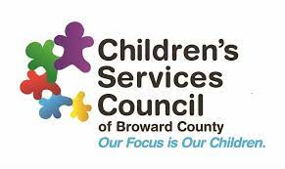
A successful Ongoing partnership
Notes:
It is a continuing partnership between the Broward County Public School, United Way of Broward County and Children Services Council.

Slide 5
Current and Past CPSV Schools
Middle School
Glades
New Renaissance
Walter C Young
Silver Trails
McNicol
Gulfstream Academy
New River
Nova
Pompano Beach
William Dandy
Crystal Lake
High School
Miramar
Flanagan
Hollywood Hills
Northeast
South Plantation
Blanche Ely
Boyd Anderson
Schools Completed
Sunrise
Apollo
Rickards
Coral Glades

Slide 6
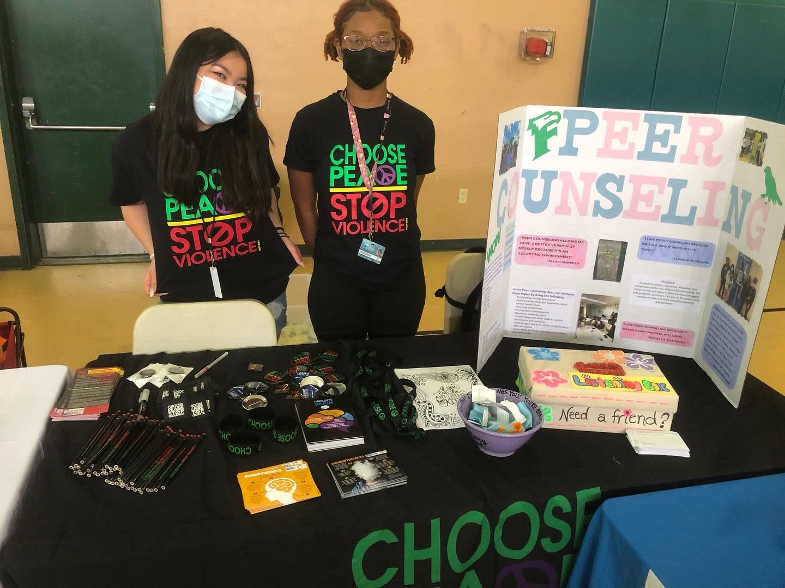
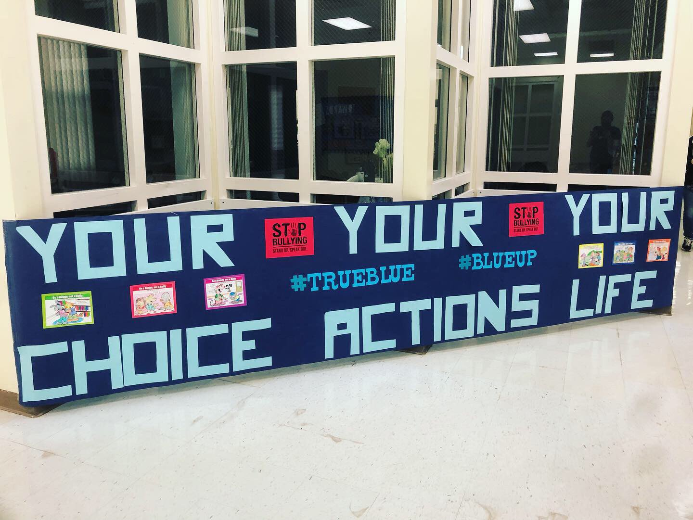
How it will help
Improve the health and safety in your community with Positive Community Norms (PCN) that promote:
Reduced rates of Acts Against Persons (fighting, assault/threat, bullying, etc.) in student discipline.
Improved student resiliency, pro-social behavior, and social-emotional learning.
Increased school-wide awareness of bullying, violence prevention, and social justice issues.
Increased student civic and academic engagement.
Notes:
This is what the data show
Improve the health and safety in your community with Positive Community Norms (PCN), an approach that promotes protective factors, increases healthy norms, and changes community cultures on issues including substance use, traffic safety, child maltreatment, youth suicide, and more. PCN can help you design and implement powerful communications campaigns that shift perceptions, attitudes, and behaviors to achieve authentic community transformation. We want to grow the positive in our communities and highlight all the prevention work that are our schools are already doing to continue to improve school climate.

Slide 7
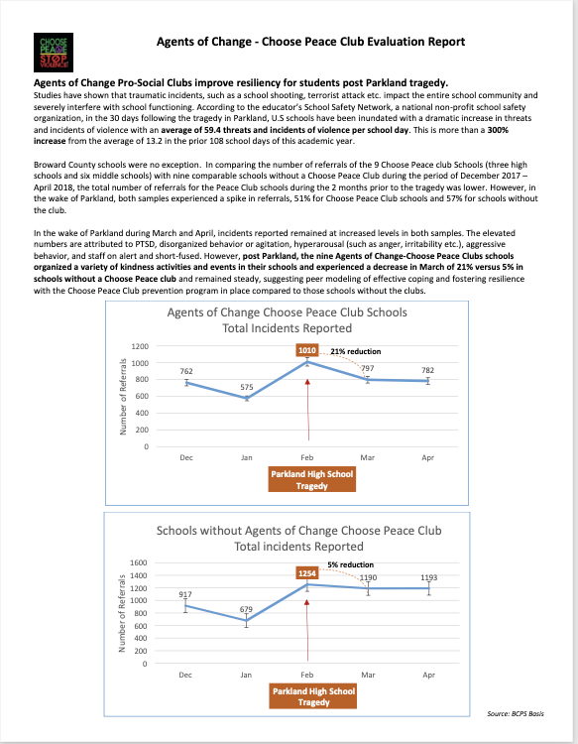
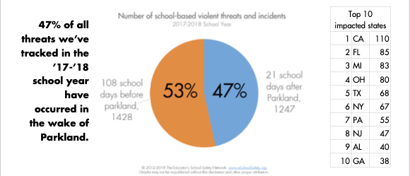
Data from Past CPSV prevention work

Slide 8
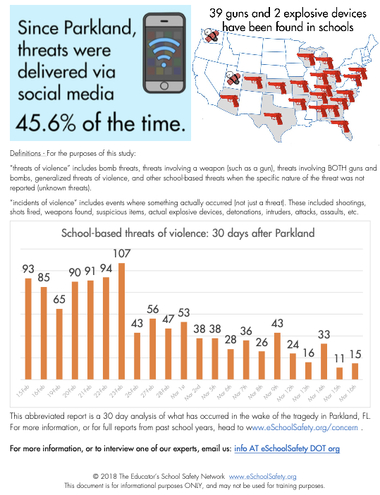

Slide 9
Social Norms Theory
Because of misperceptions,
the theory predicts that
problem behavior increases and
healthy behavior decreases.
Notes:
Social Norms are people's belief about the attitudes and behaviors that are normal, acceptable, or even expected in a particular social context. In many situations, people's perception of these norms will greatly influence their behavior. According to the social norm's theory, people tend to misperceive, i.e., exaggerate the negative health behavior of their peers. If people think harmful behavior is typical, they are most likely to engage in that type of behavior. Therefore, we want to change perception to match reality and for the most part our students are doing the right thing.
Schools use their own data to create the pro-social marketing…. Celebrating and encourage the healthy behavior

Slide 10
Our behavior follows our belief of what the “Norm” is
The REALITY of Other’s Behavior/Values
Me
My Behavior
My PERCEPTON of Other’s Behavior/Values
Notes:
THE REASON THIS INFORMATION IS ESSENTIAL TO TEACH TO OUR CHILDREN, STUDENTS, PARENTS AND TEACHERS: Social Norms - Perception LEADS Reality
This is a method of marketing and intervention that has been greatly researched and it is even something we use in Broward County to intervene and reduce substance use in some of our high schools.
It is based on the fact that people’s PERCEPTIONS are almost always that the majority of us are acting MAL-adaptively – in other words, the norm is to behave badly.
For example:
if we are in are in college, we don’t drink and drive regularly, but we assume everybody else does.
If we are a parent, I read to my child every night, but I don’t think most other parents do.
The REALITY though is that the majority are acting in a HEALTY adaptive way.
Examples:
The majority of parents do read to their kids at night
In studying college kids, it was found that they really weren’t drinking that much, but since they did not want to be seen as different, many had developed drinking habits that hid and controlled it (i.e.- putting straws in their pockets to count the number of drinks they consumed, they would empty their beer cans and fill them with water when walking around at a party).
WHY is this important? If you educate, the perception becomes more adaptive and the behavior follows.

Slide 11
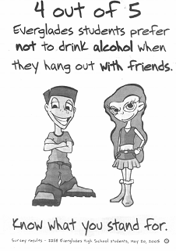
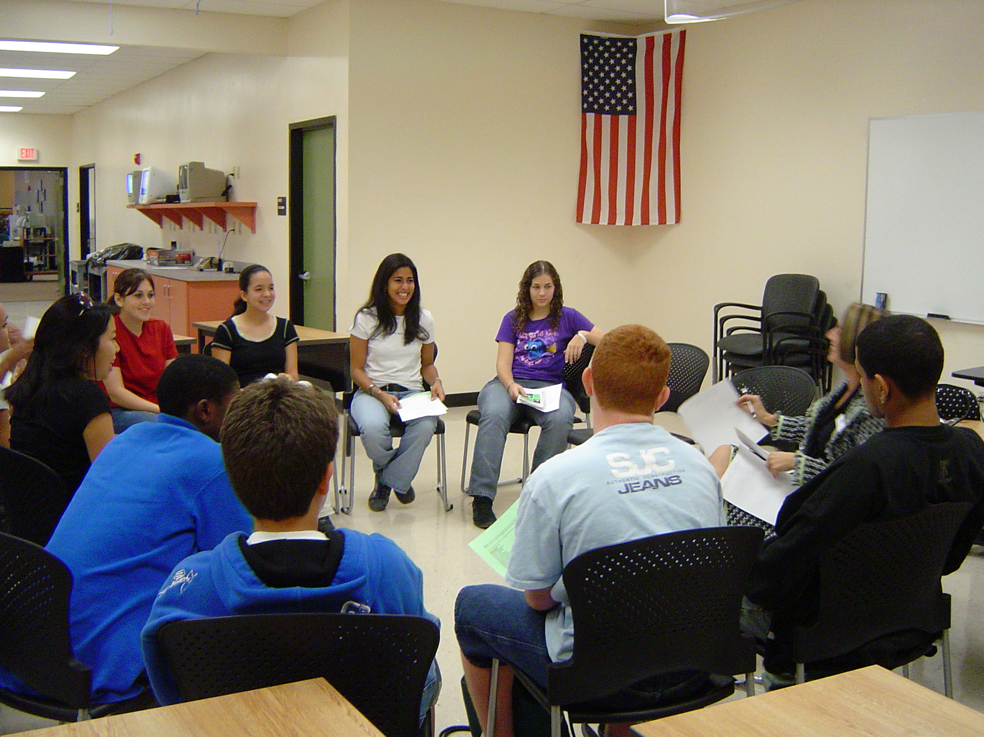
Agents of Change
Students Convert Data to Social Norms Messaging
CPSV Clubs meet 1-2 times a month to plan 2 community service projects and/or school-wide prevention observance events.

Slide 12
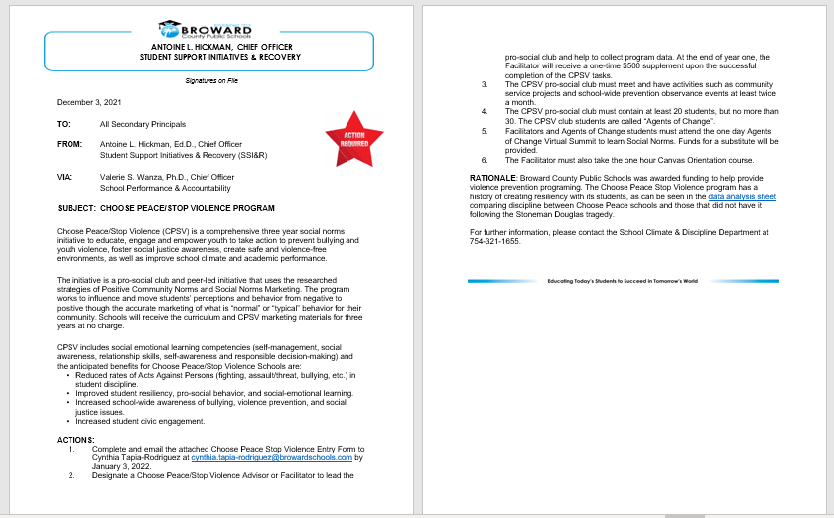
Making CPSV districtwide

Slide 13
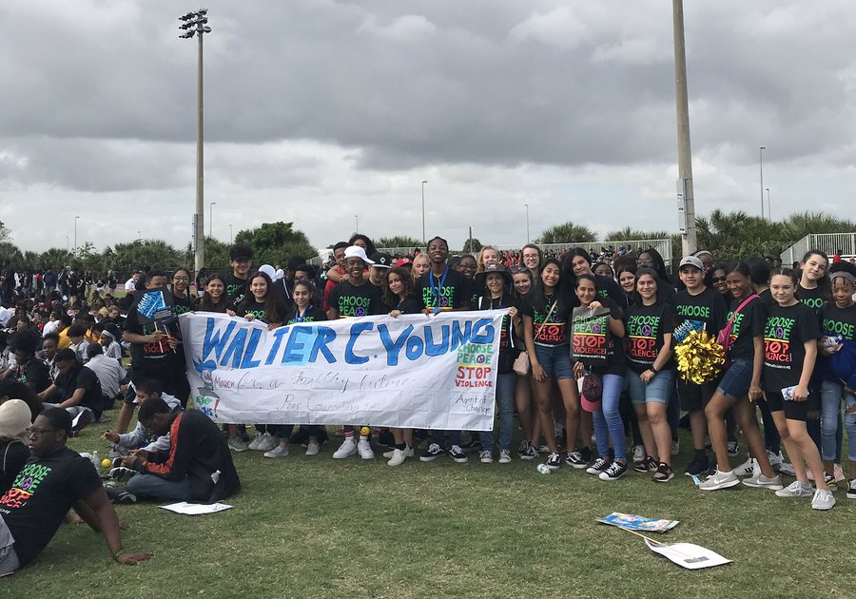
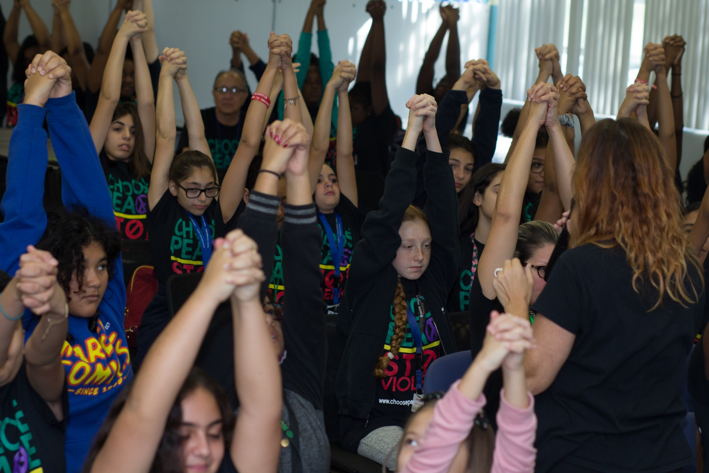
What schools will do?
Developing media campaigns to address normative misperception​
To influence behaviors that benefit individuals and communities for the greater social good ​
Using social norms marketing to inform our community that the majority of their peers do NOT engage in risky behaviors, can potentially lead them to avoid negative influences​
The campaign messages should be designed to correct the misperception about bullying and violence and to promote kindness

Slide 14
ENTRY FORM

Slide 15
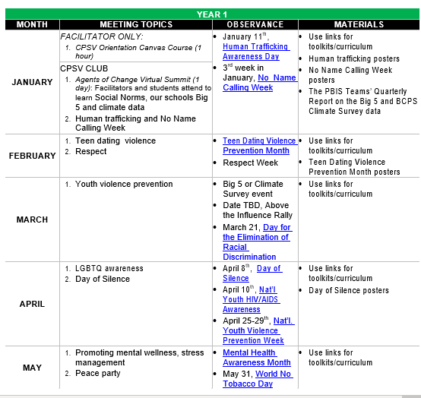
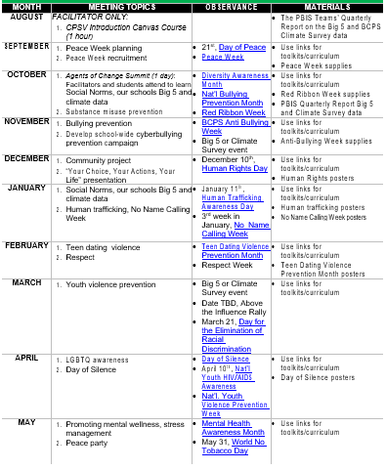
PRO-SOCIAL CLUB YEARLY TIMELINE
Year 1
Stipend for Facilitator
Year 2 and 3
Materials Only
Notes:
Three Years

Slide 16

Notes:
SAVE Promise Clubs
Sustain the Start With Hello message with a SAVE (Students Against Violence Everywhere) Promise Club. SAVE Promise Clubs are a place for young people across the country to show their leadership, creativity, and passion for protecting their friends, schools, and communities from violence before it happens. For additional ideas on how to sustain Start with Hello and empower your students to look out for one another and be leaders, visit SAVE Promise Club to learn more.

Slide 17

S.A.V.E PROMISE CLUB (SPC)
Currently in almost 100 of about 144 elementary schools
The pro-social club Facilitator receives an annual $384 supplement
Yearly deliverables
  Meet at least 1 time a month
  Have at least 1 schoolwide event a month
  Kick off each year with Start with Hello observance
Notes:
Stipend $384 (2- $100 & 1-$184)
Implementation Plan
Team Channel
Monthly Meetings
Dates of Observance

Slide 18
THANK YOU

